Slide 1
Applications of Bit Manipulation

Slide 2
Outline
Applications of Shift and Rotate (7.2.1 and 7.2.2 KI Chapter 4 BH)
Multiplication
Extended Addition/Subtraction

Slide 3
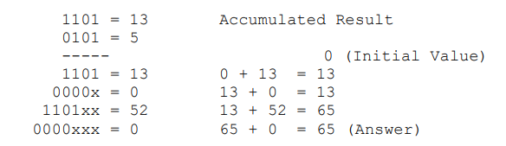
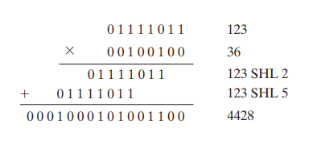
MULTIPLICATION IN ASSEMBLY LANGUAGE
4 bit multiplication
Shift the multiplier to the right.
If CF=1
add the multiplicand to the result.
Shift the multiplicand to the left.
Repeat the algorithm 4 times.
For 4 bit multiplication, multiplicand and result should be 8 bit.
Similarly, for n bit multiplication, multiplicand and result should be 2*n bits.

Slide 4
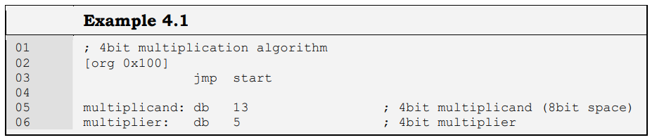
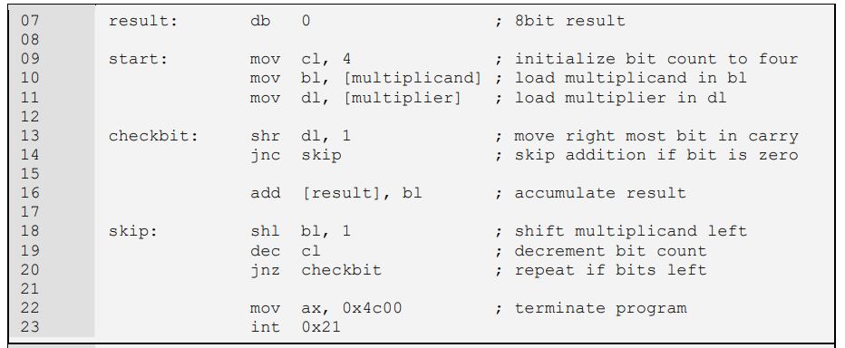

Slide 5
Question
Modify the algorithm given in last slide for 8 bit multiplication.
How will you modify the algorithm given in last slide for 16 or 32 bit multiplication?

Slide 6
EXTENDED OPERATIONS
Working with larger numbers
For example
Adding/Subtracting 32 bit or 64 bit numbers
Multiplying 16 or 32 or 64 bit numbers
Shifting 32 bit number

Slide 7
Extended Multiplication
Take an example of multiplying two 16 bit numbers.
The result will need 32 bits and multiplicand will also need 32 bits.
This will require SHL 32 bit multiplicand and addition of 32 bit multiplicand and 32 bit result.
So to perform extended multiplication we should first look at extended addition and extended shifting.
Reminder the one instruction of add or SHR only works for 8 or 16 bits

Slide 8
Extended Shifting Left
Consider a 32 bit number num1
num1: dd 0000 0000 0000 0000 1111 0000 1111 0000b
Note spaces are just there for readability.
How will you Shift it left by 1 such that the result is
num1: dd 0000 0000 0000 0001 1110 0001 1110 0000b

Slide 9
Extended Shifting Left
You will use two instructions
shl word [num1], 1
rcl word [num1+2], 1
Effect of 1st instruction: shl word [num1], 1
num1: dd 0000 0000 0000 0000 1110 0001 1110 0000 b
CF=1
Effect of 2nd Instruction rcl word [num1+2], 1
num1: dd 0000 0000 0000 0001 1110 0001 1110 0000 b
CF= 0

Slide 10
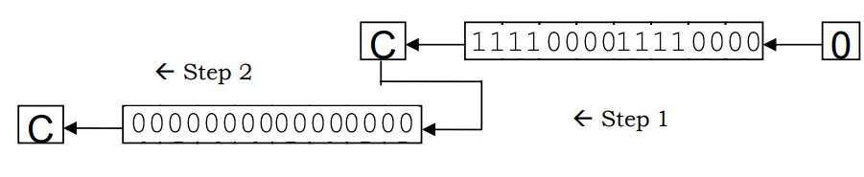
Extended Shifting left

Slide 11
Extended Shifting Right
Consider a 32 bit number num1
num1: dd 0000 0000 0000 0001 0000 0000 0000 0000b
Note spaces are just there for readability.
How will you Shift it Right by 1 such that the result is
num1: dd 0000 0000 0000 0000 1000 000 0000 0000b

Slide 12
Extended Shifting Right
You will use two instructions
shr word [num1+2], 1
rcr word [num1], 1
Effect of 1st instruction: shr word [num1+2], 1
num1: dd 0000 0000 0000 0000 0000 0000 0000 0000b
CF=1
Effect of 2nd Instruction rcr word [num1], 1
Num1: dd 0000 0000 0000 0000 1000 0000 0000 0000 b
CF= 0

Slide 13
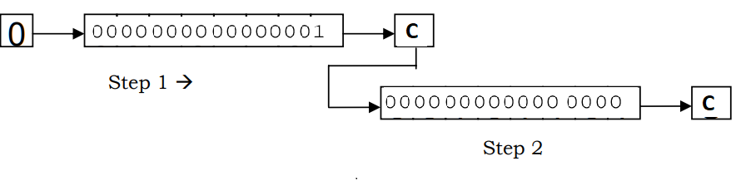
Extended Shifting Right

Slide 14
Extended Shift
How will you shift right a 64 bit number?

Slide 15
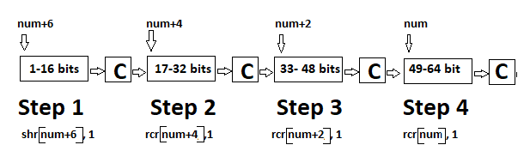
Extended Shift
How will you shift right a 64 bit number?
Answer

Slide 16
Extended Shift
How will you shift left a 64 bit number?

Slide 17
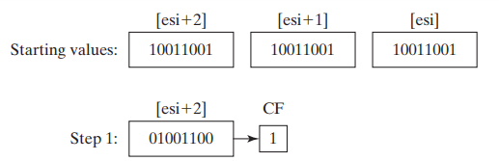
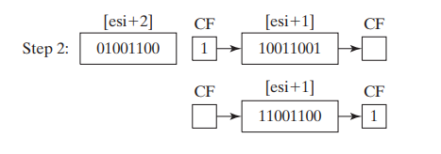
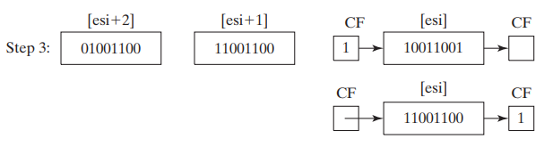
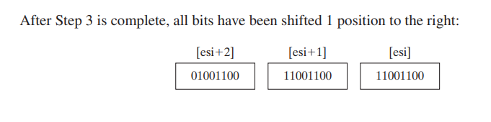
Another Example

Slide 18
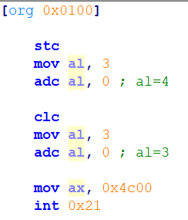
Extended Addition
ADC, Addition with Carry will help use to perform extended addition.
How ADC works
ADC ax, bx; this is equivalent to ax+bx+CF
Notes:
[org 0x0100]
stc
mov al, 3
adc al, 0 ; al=4
clc
mov al, 3
adc al, 0 ; al=4
mov ax, 0x4c00
int 0x21

Slide 19
Extended Addition
For adding numbers with n words
Add nth Words of first and second operand
for i in n-1 to 1
add with carry the ith word of first and ith word of second operand

Slide 20
Extended Addition (Example)
Example:
Adding 64 bits
Initially
num1: | 1000 1000 0000 0000 | 0110 0000 1111 1111 | 0100 0000 0000 0000 | 1111 1111 1111 1111
num2: | 1000 1111 0000 1111 | 0000 0000 0000 0000 | 0100 0000 0000 0001 | 1000 0000 0000 0000
result: | 0000 0000 0000 0000 | 0000 0000 0000 0000 | 0000 0000 0000 0000 | 0000 0000 0000 0000

Slide 21
Extended Addition (Example)
Step 1
mov ax, [num1]
mov bx, [num2]
add ax, bx
mov [result], ax
After Step 1: CF=1
num1: | 1000 1000 0000 0000 | 1110 0000 1111 1111 | 0100 0000 0000 0000 | 1111 1111 1111 1111
num2: | 1000 1111 0000 1111 | 1000 0000 0000 0000 | 0100 0000 0000 0001 | 1000 0000 0000 0000
result: | 0000 0000 0000 0000 | 0000 0000 0000 0000 | 0000 0000 0000 0000 | 0111 1111 1111 1111

Slide 22
Extended Addition (Example)
Step 2
mov ax, [num1+2]
mov bx, [num2+2]
adc ax, bx
mov [result+2], ax
After Step 2: CF=0
num1: | 1000 1000 0000 0000 | 1110 0000 1111 1111 | 0100 0000 0000 0000 | 1111 1111 1111 1111
num2: | 1000 1111 0000 1111 | 1000 0000 0000 0000 | 0100 0000 0000 0001 | 1000 0000 0000 0000
result: | 0000 0000 0000 0000 | 0000 0000 0000 0000 | 1000 0000 0000 0010 | 0111 1111 1111 1111

Slide 23
Extended Addition (Example)
Step 3
mov ax, [num1+4]
mov bx, [num2+4]
adc ax, bx
mov [result+4], ax
After Step 3: CF=1
num1: | 1000 1000 0000 0000 | 1110 0000 1111 1111 | 0100 0000 0000 0000 | 1111 1111 1111 1111
num2: | 1000 1111 0000 1111 | 1000 0000 0000 0000 | 0100 0000 0000 0001 | 1000 0000 0000 0000
result: | 0000 0000 0000 0000 | 0110 0000 1111 1111 | 1000 0000 0000 0010 | 0111 1111 1111 1111

Slide 24
Extended Addition (Example)
Step 4
mov ax, [num1+6]
mov bx, [num2+6]
adc ax, bx
mov [result+6], ax
So the result of addition is
CF=1 , 0001 0111 0001 0000 0110 0000 1111 1111 1000 0000 0000 0010 0111 1111 1111 1111
Note that the carry of the Most significant word is stored in CF using these 4 steps
After Step 4: CF=1
num1: | 1000 1000 0000 0000 | 1110 0000 1111 1111 | 0100 0000 0000 0000 | 1111 1111 1111 1111
num2: | 1000 1111 0000 1111 | 1000 0000 0000 0000 | 0100 0000 0000 0001 | 1000 0000 0000 0000
result: | 0001 0111 0001 0000 | 0110 0000 1111 1111 | 1000 0000 0000 0010 | 0111 1111 1111 1111

Slide 25
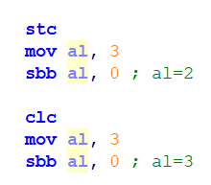
Extended Subtraction
For subtraction the same logic will be used and just like addition with carry there is an instruction to subtract with borrows called sbb.
sbb ax, bx; this is equivalent to ax-bx-CF
Notes:
[org 0x0100]
stc
mov al, 3
sbb al, 0 ; al=2
clc
mov al, 3
sbb al, 0 ; al=3
mov ax, 0x4c00
int 0x21

Slide 26
Extended Subtraction
For subtracting numbers with n words
Sub nth Words of first and second operand
for i in n-1 to 1
Subtract with borrow the ith word of first and ith word of second operand

Slide 27
Extended Subtraction (Exercise)
Example:
Subtracting 64 bits
Work out the given subtraction as we did addition, show each step
Initially
num1: | 1000 1000 0000 0000 | 0110 0000 1111 1111 | 0100 0000 0000 0000 | 1111 1111 1111 1111
num2: | 1000 1111 0000 1111 | 0000 0000 0000 0000 | 0100 0000 0000 0001 | 1000 0000 0000 0000
result: | 0000 0000 0000 0000 | 0000 0000 0000 0000 | 0000 0000 0000 0000 | 0000 0000 0000 0000

Slide 28
Question
Given two operands of n words, if you know the value of n write the code of adding these two operands in a loop.
Given two operands of n words, if you know the value of n write the code of subtracting these two operands using a loop.

Slide 29
Extended Multiplication
On slide 4 we saw an example to multiply 4 bit numbers.
The same algorithm can be now used to multiply a numbers of any size.
The algorithm was as follow
Shift the multiplier to the right. (now you know how to use extended shift)
If CF=1
add the multiplicand to the result. (now you know how to use extended addition)
Shift the multiplicand to the left.
Repeat the algorithm n times. (where n is size of multiplier)

Slide 30
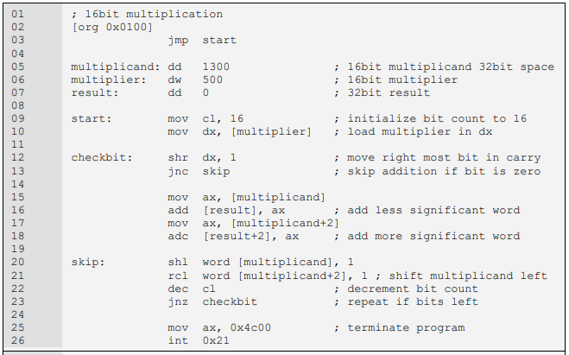
Notes:
Note that 16 bit X is extended as the result needs 32 bit, actually the result can be 33 bits where 1 bit is stored in CF
The multiplier is still stored in 16bits since we only need to check its bits one by one.
The multiplicand however cannot be stored in 16bits otherwise on left shifting its significant bits might get lost.

Slide 31
Example
Change the code give in previous slide to work for 32 bit multiplication i.e. the result should be 64 bit

Slide 32
BITWISE LOGICAL OPERATIONS

Slide 33
BITWISE LOGICAL OPERATIONS
AND operation
Examples are “and ax, bx” and “and byte [mem], 5.”
All possibilities that are legal for addition are also legal for the AND operation. The different thing is the bitwise behavior of this operation.
OR operation
Examples are “or ax, bx” and “or byte [mem], 5.”
XOR operation
Examples are “xor ax, bx” and “xor byte [mem], 5
NOT operation
Examples are “not ax” and “not byte [mem]”.

Slide 34
MASKING OPERATIONS
Selective Bit Clearing
Done using AND operations
Example to clear the LSB in AL, used AND AX, 11111110b
This operation is called masking, 11111110 was mask in this example
Selective Bit Setting
Done using OR operations
Example to set the LSB in AL, used OR AX, 00000001b
00000001b is the mask here
Selective Bit Inversion
Done using XOR
For example to toggle LSB and MSB in AL use XOR AL, 1000 0001b

Slide 35
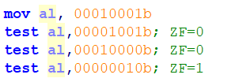
MASKING OPERATION
Selective Bit Testing
AND operation can be used to test if a certain bit in a number are set or not.
But this will change the mask or the operand.
TEST instruction is a non destructive alternative for selective bit testing.
It doesn’t change the destination and only sets the sign, zero and parity flags as would have AND operation
Next slide shows the use of test in multiplication algorithms so that multiplier is retained

Slide 36
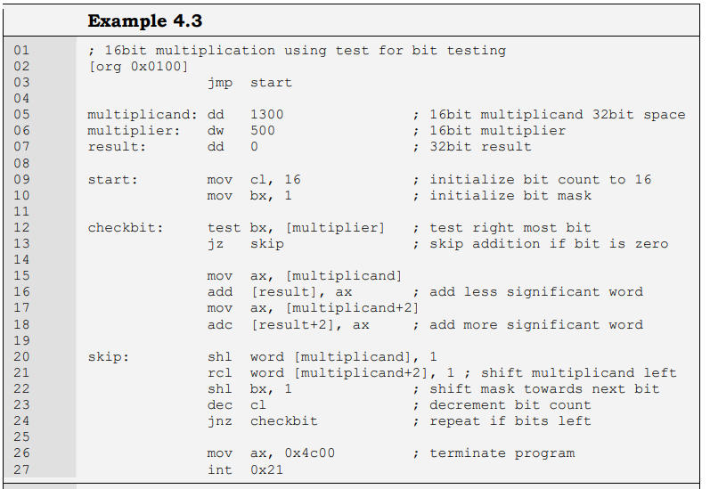
Notes:
The test instruction is used for bit testing. BX holds the mask and in every next iteration it is shifting left, as our concerned bit is now the next bit.
We can do without counting in this example. We can stop as soon as our mask in BX becomes zero. These are the small tricks that assembly allows us to do and optimize our code as a result.

Slide 37
Reading
Chapter 4 Bilal Hashmi

Slide 38
References
https://sites.google.com/view/coal-fall-2019

